Slide 1
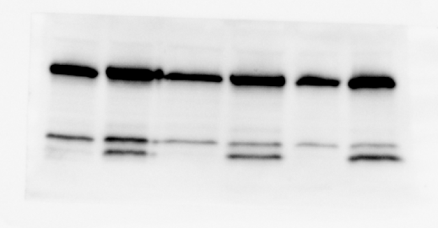
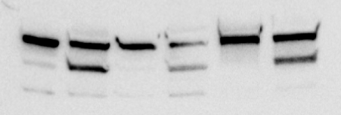
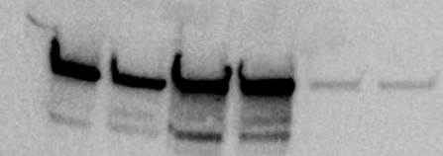
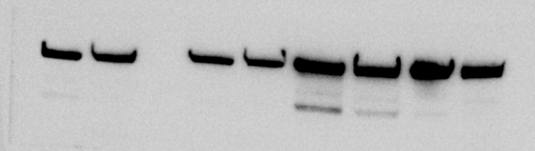
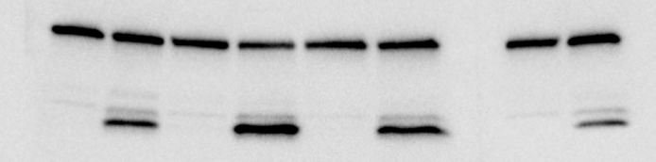
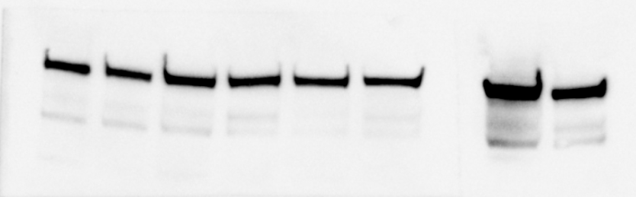
Fig. 1D, left panel
Meds433 100nM
Meds433 100nM
control
control
PARP
Caspase 3
Cleaved PARP
Cleaved caspase 3
Vinculin
Vinculin
Fig. 1D, right panel
Meds433 100nM
Meds433 100nM
control
control
PARP
Caspase 3
Cleaved PARP
Cleaved caspase 3
Tubulin
Vinculin

Slide 2

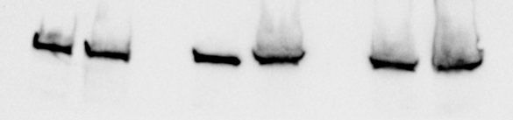
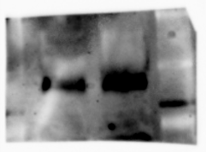
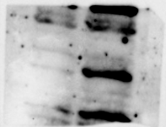


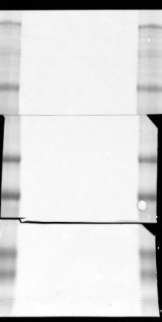
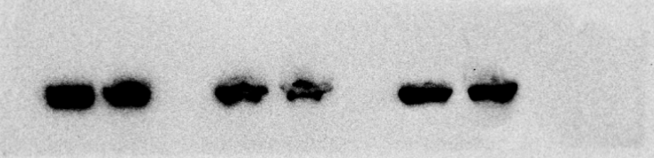
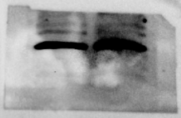
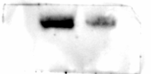
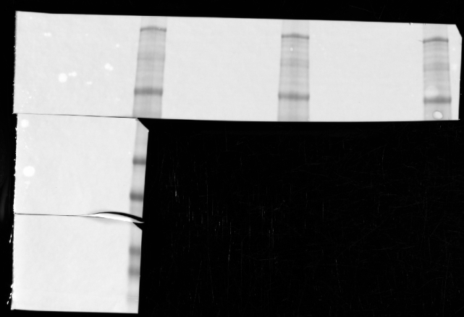
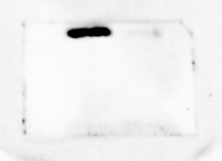
Fig. 4D
Meds433 100nM
control
Meds433 100nM
Vinculin
control
Vinculin
p53
c-jun
Puma
Meds433 100nM
control
Meds433 100nM
Vinculin
control
Vinculin
Bax
c-myc
Cyclin D1

