Slide 1

Surgical management and outcomes in patients with acute type A aortic dissection and cerebral malperfusion
Igor Vendramin, MD, Miriam Isola, MD, Daniela Piani, MD, Francesco Onorati, MD, Stefano Salizzoni, MD, Augusto D'Onofrio, MD, Luca Di Marco, MD, Giuseppe Gatti, MD, Maria De Martino, MD, Giuseppe Faggian, MD, Mauro Rinaldi, MD, Gino Gerosa, MD, Davide Pacini, MD, Aniello Pappalardo, MD, Ugolino Livi, MD
JTCVS Open
Volume 10 Pages 22-33 (June 2022)
DOI: 10.1016/j.xjon.2022.03.001
Copyright © 2022 The Author(s) Terms and Conditions

Slide 2
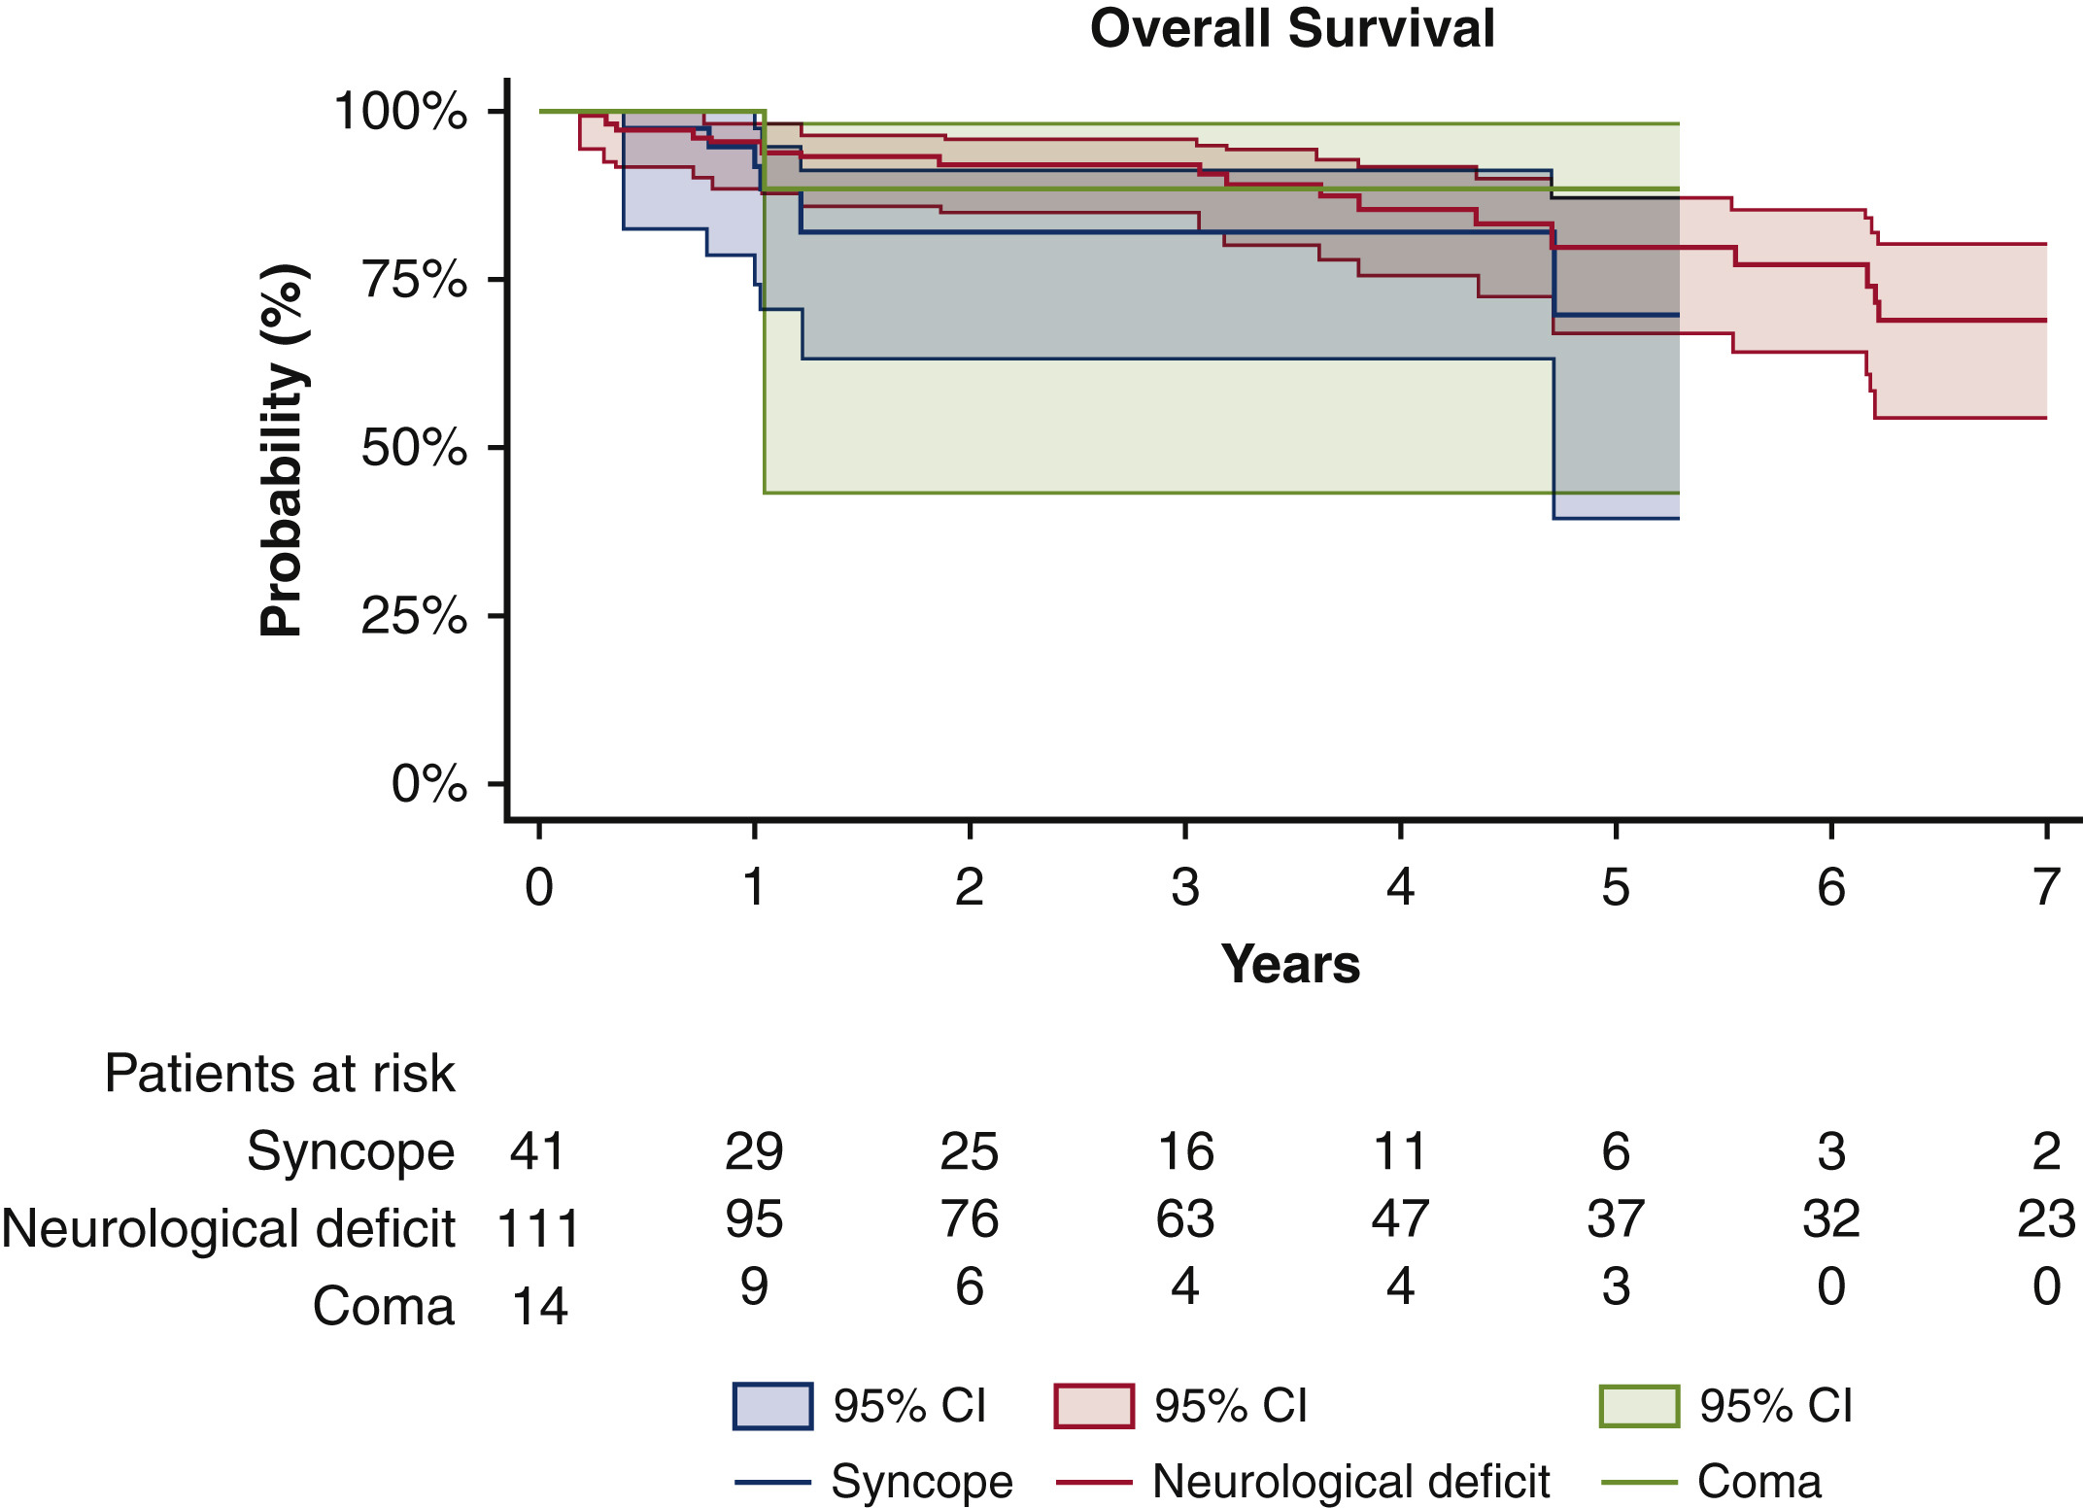
Figure E1
JTCVS Open 2022 1022-33DOI: (10.1016/j.xjon.2022.03.001)
Copyright © 2022 The Author(s) Terms and Conditions
Notes:
Overall survival for hospital patients who survived was not significantly different among the 3 groups (P = .366). CI, Confidence interval.

