Slide 1
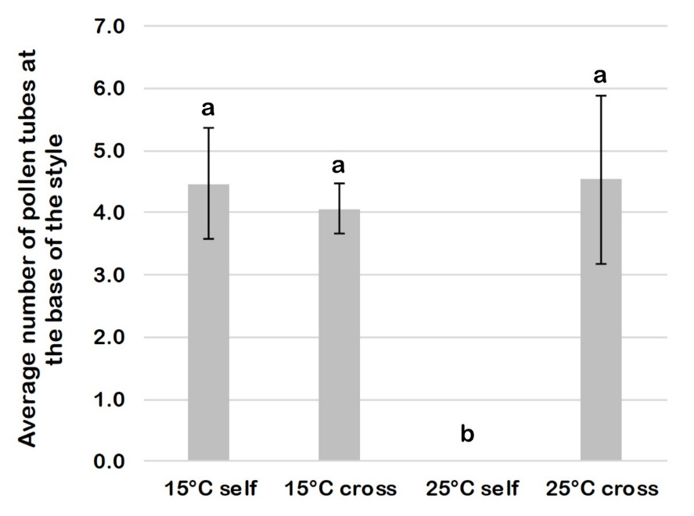
Supplementary figure 2.
Average number of pollen tubes at the base of the style based on 15 flowers analyzed for each sample: 15°C self and cross and 25°C self and cross-pollinated. The data were analyzed by one-way ANOVA test, with Tukey’s post-test. Values of p < 0.05 were considered statistically significant. Different letters indicate significant differences at p < 0.05. Means ± S.D.

