Slide 1
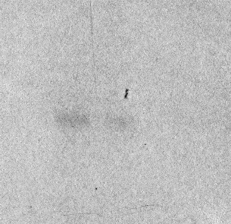
Co
CLV3-mGFP5
chase h: 0 0 1 2 3
- 46
CLV3-mGFP5
- 30
Fig. S1. Intact CLV3-mGFP5 rapidly disappears in Arabidopsis protoplasts. Protoplasts prepared from rosette leaves of Arabidopsis (Wassilewskija ecotype) were transformed with plasmids encoding CLV3-mGFP5 or empty plasmid (Co) as a control. Transformed protoplasts were then pulse-labeled for 1 h with [35S]Met and [35S]Cys and subjected to chase for the indicated h. Homogenates of protoplasts were immunoselected with anti-GFP serum and analyzed by SDS-PAGE and fluorography. The positions of molecular mass markers (in kD) are shown at right.
Fig. S1

