Slide 1
SUPPLEMENT DATA

Slide 2
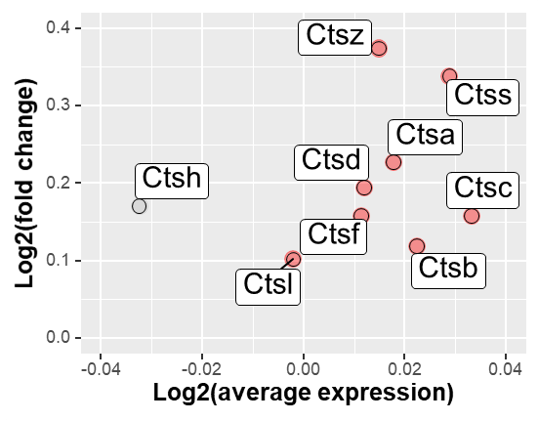
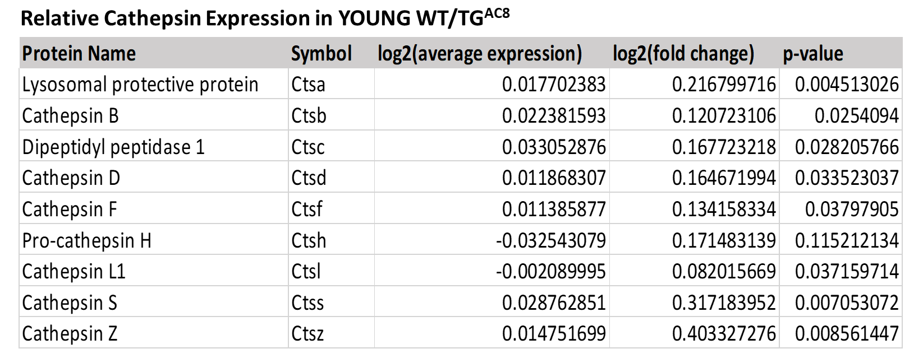
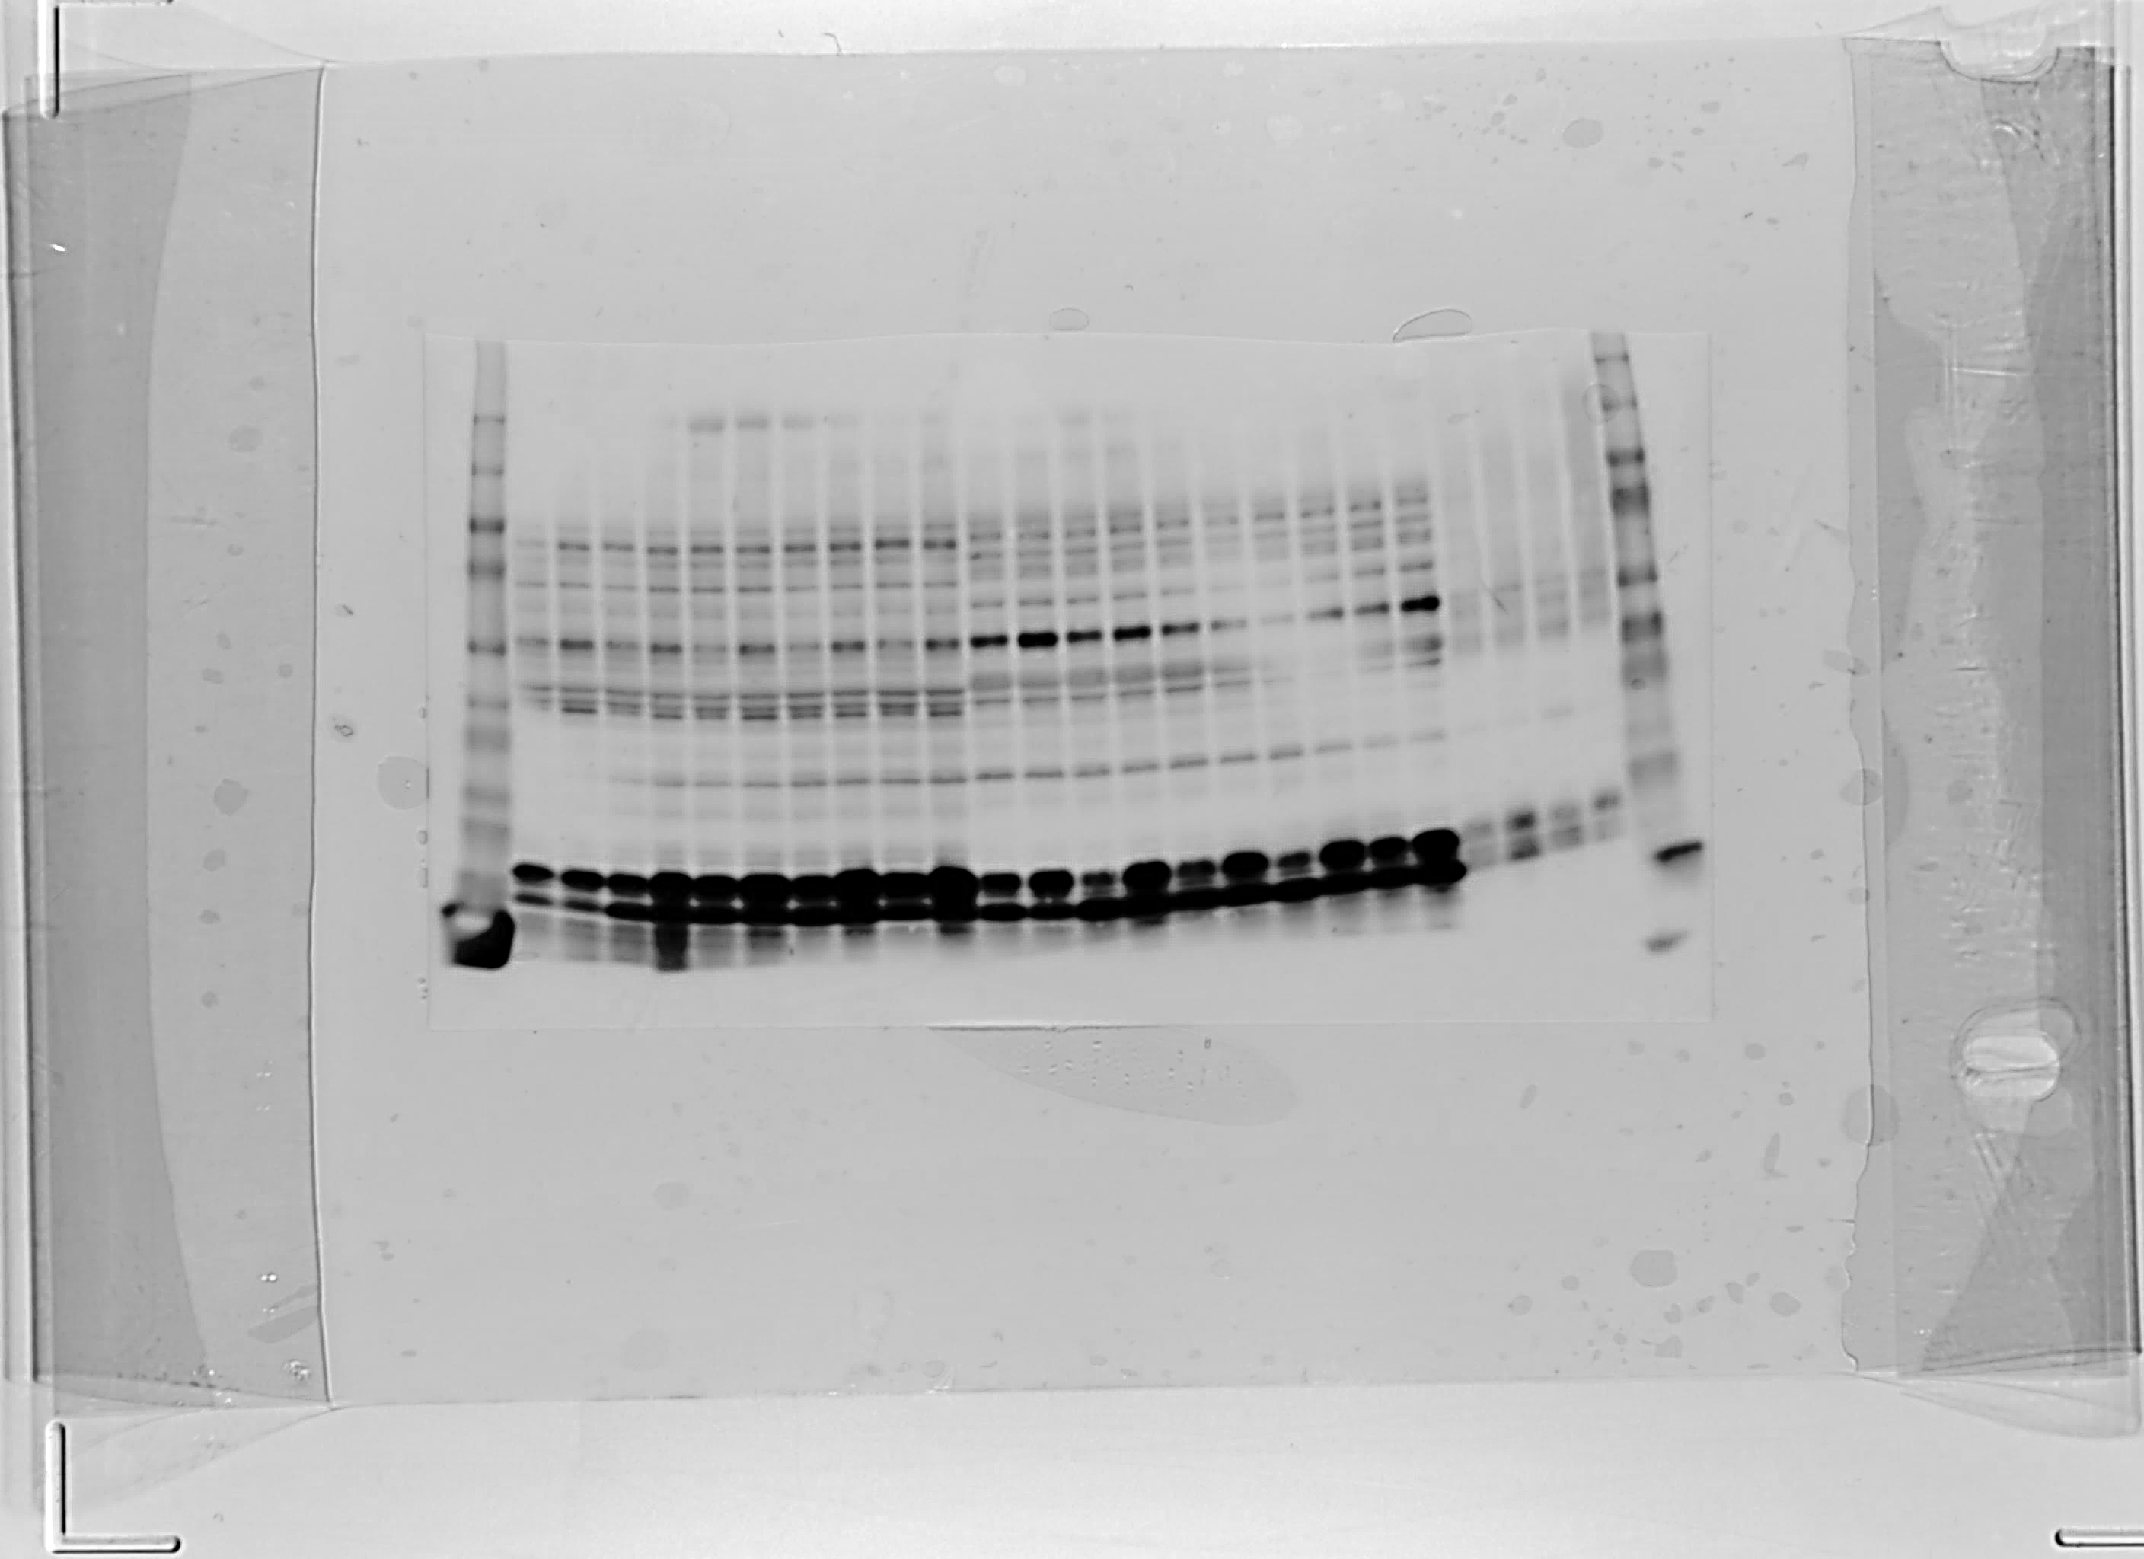
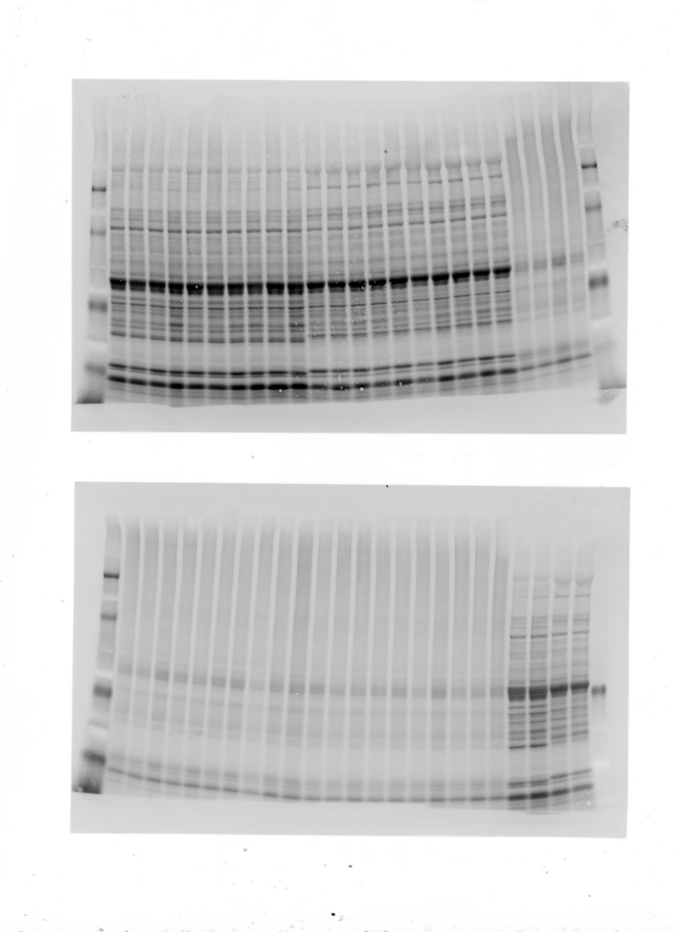
A
MA plot of Cathepsins
up: p-value < 0.05
log2(fold change) > 0
non: p-value >= 0.05
B
C
Lysosomal acid phosphatase
WT
TG^{AC8}
76KDa-
52KDa-
-ACP2
Total Protein
Supplemental Figure 1

Slide 3
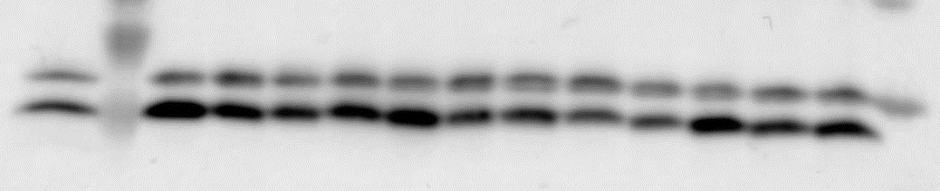
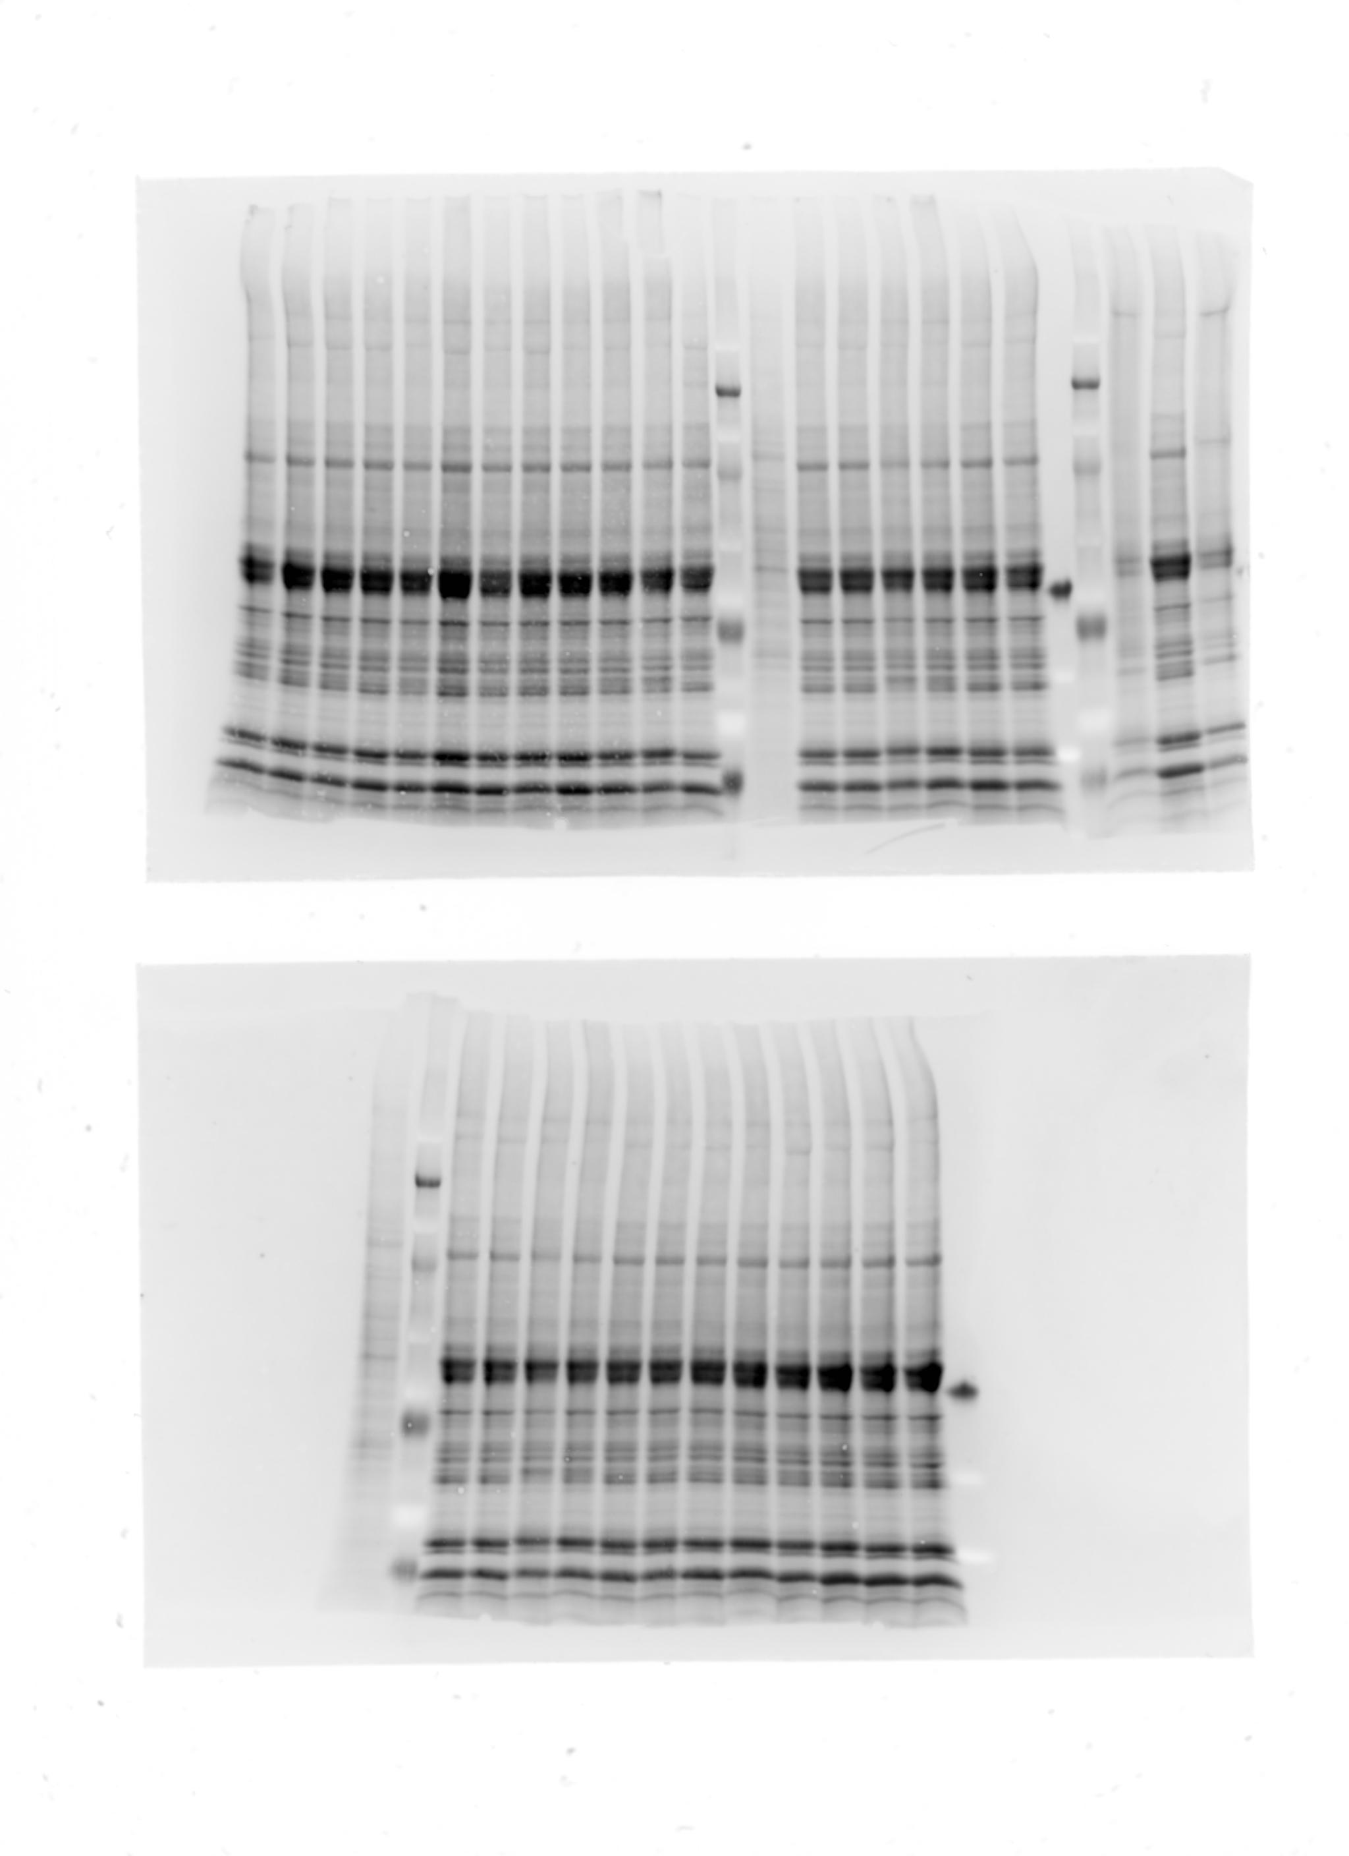
+
Saline 2h
CQ 2h
Saline 6h
CQ 6h
17KDa-
-LC3ABI
12KDa-
-LC3ABII
Total
Protein
Autophagic flux was measured in non-fasting conditions to specifically assess steady state autophagy (Figure S1).
Supplemental Figure 2
Notes:
Optimizing the protocol to both detect LC3II accumulation in WT and excluding the possibility of a remaining residual flux, if inhibition is incomplete.

Slide 4
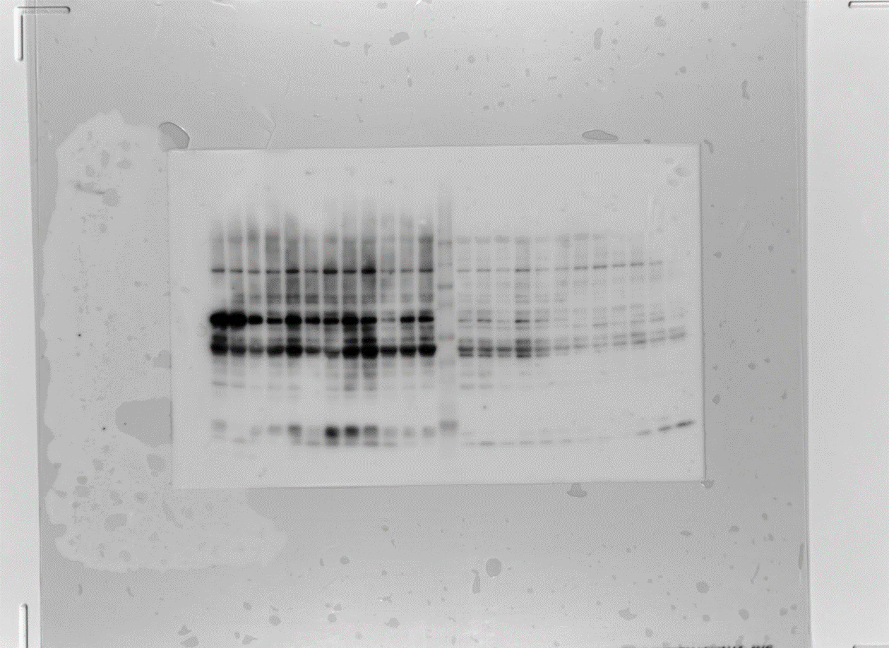
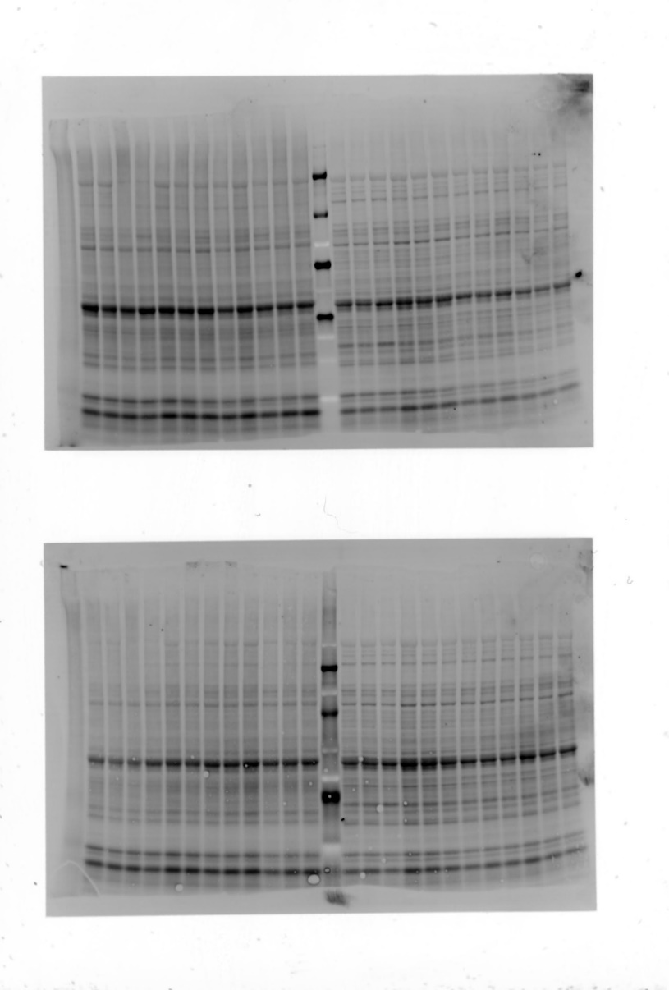
YOUNG
OLD
WT
TG^{AC8}
WT
TG^{AC8}
Saline
CQ
Saline
CQ
Saline
CQ
Saline
CQ
ATG4B-
-48-50KDa
Total Protein
20
22
1
19
2
3
4
5
6
7
8
9
10
11
12
13
14
15
16
17
18
21
23
24
Supplemental Figure 3
Notes:
A concentration-curve and time-course standardization for the use of autophagic flux inhibitors is required for the initial optimization of the conditions to detect LC3-II accumulation and avoid nonspecific or secondary effects, and to exclude the possibility of a remaining residual flux, if inhibition is incomplete.
It should be cautioned that such LC3 assays are merely indicative of autophagic “carrier flux”, not of actual autophagic cargo/substrate flux. Flux of an autophagic carrier may not necessarily be equivalent to autophagic cargo flux.

Slide 5
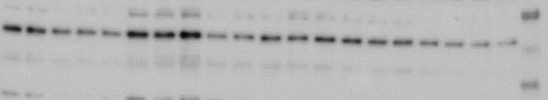
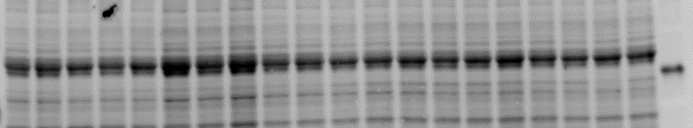
A
B
WT Saline
WT CQ
TG^{AC8} Saline
TG^{AC8} CQ
FKBP8-
-76KDa
-52KDa
-38KDa
Total
Protein
Supplemental Figure 4
Notes:
A concentration-curve and time-course standardization for the use of autophagic flux inhibitors is required for the initial optimization of the conditions to detect LC3-II accumulation and avoid nonspecific or secondary effects, and to exclude the possibility of a remaining residual flux, if inhibition is incomplete.
It should be cautioned that such LC3 assays are merely indicative of autophagic “carrier flux”, not of actual autophagic cargo/substrate flux. Flux of an autophagic carrier may not necessarily be equivalent to autophagic cargo flux.

Slide 6
Supplemental Figure 5
Notes:
……although there were no individual genes passing false discovery rate-adjusted P value.

Slide 7
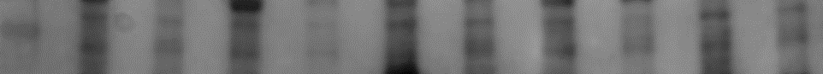
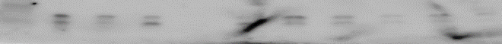
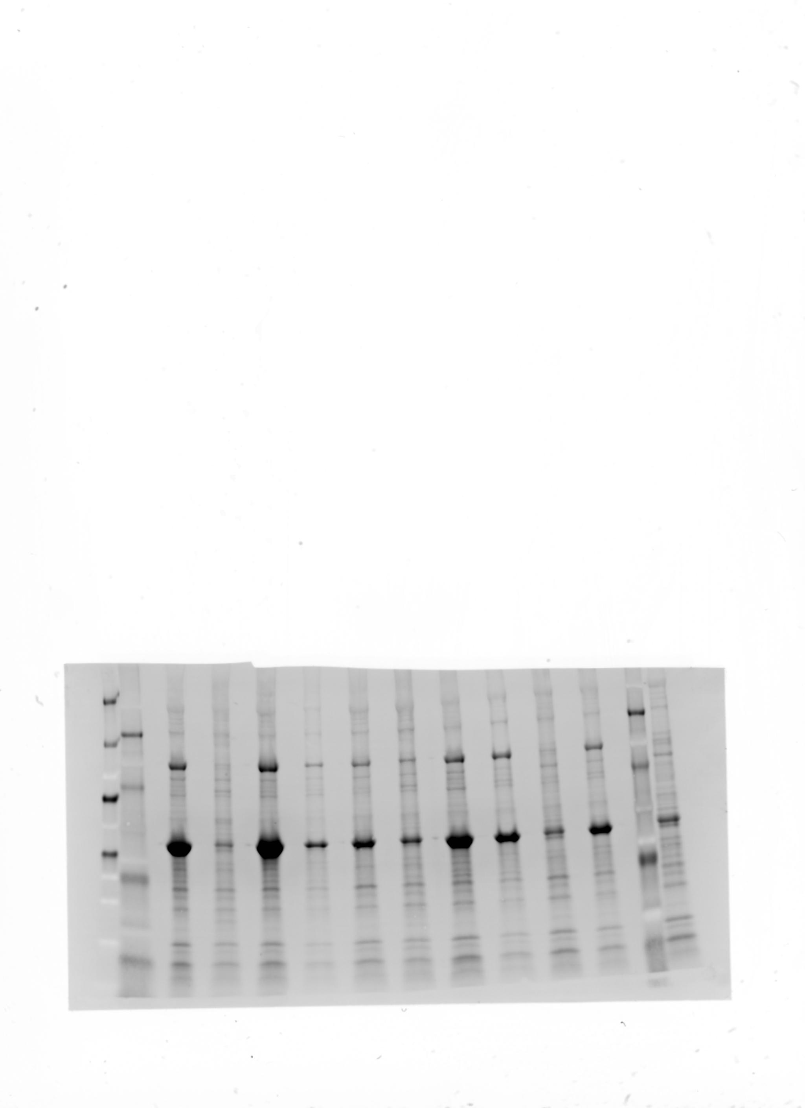
A
B
C
M
WT
TG^{AC8}
WT
TG^{AC8}
WT
TG^{AC8}
WT
TG^{AC8}
WT
TG^{AC8}
p62-
-62KDa
LC3AII-
-15KDa
Total
Protein
Supplemental Figure 6

Slide 8
Supplemental Figure 7

Slide 9
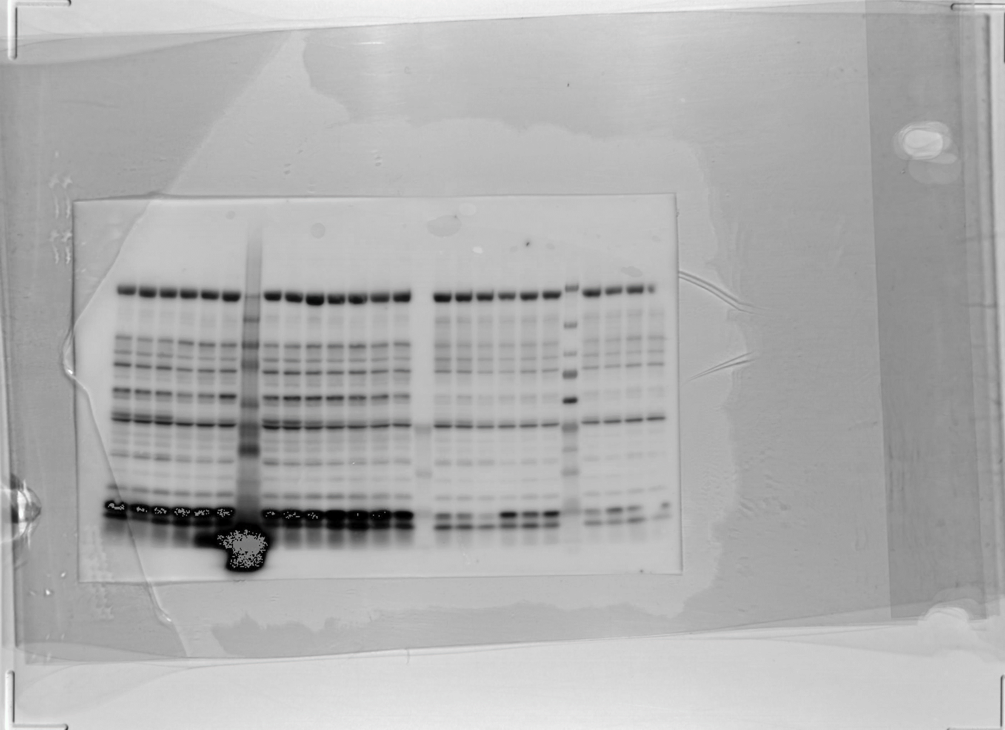
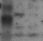
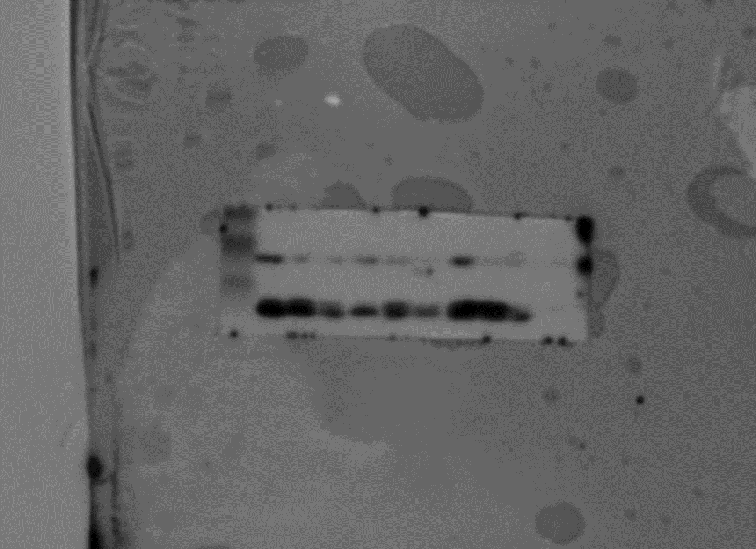
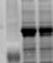
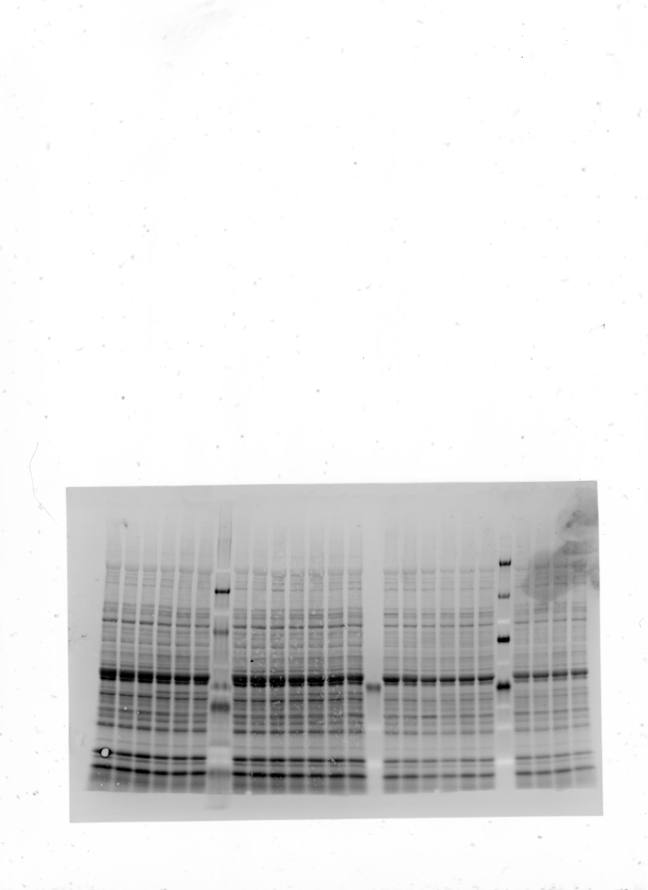
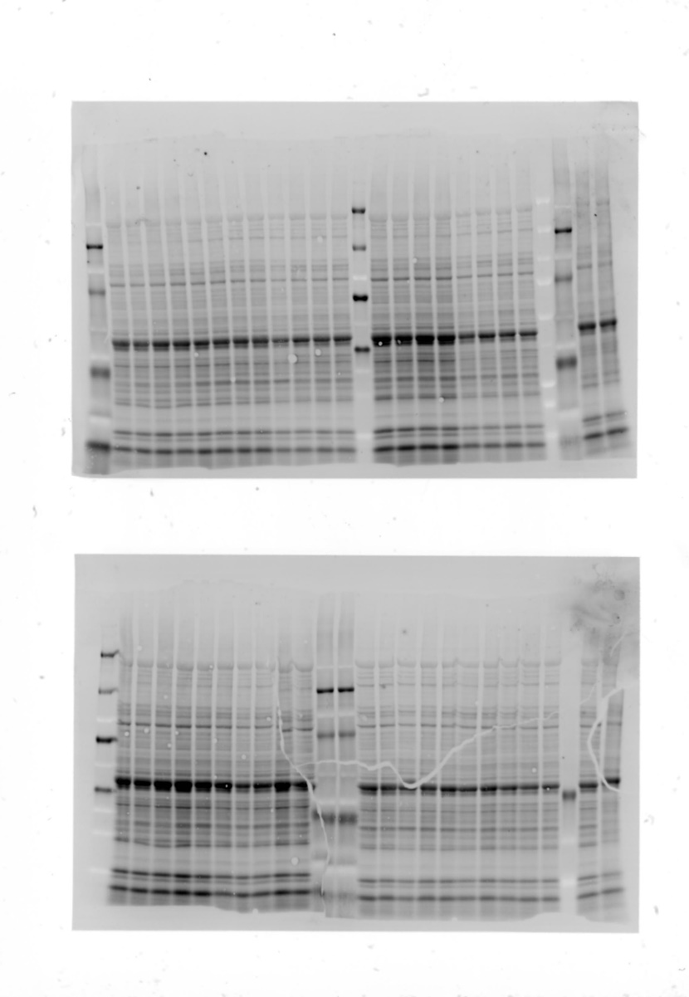
A
B
C
WT
TG^{AC8}
WT
TG^{AC8}
TG^{AC8}
TG^{AC8}
TG^{AC8}
76KDa-
WT
WT
WT
17KDa-
17KDa-
52KDa-
-ACP2
12KDa-
LC3^{S12}
LC3^{T50}
15KDa-
Total Protein
Total Protein
Total Protein
Supplemental Figure 8

Slide 10
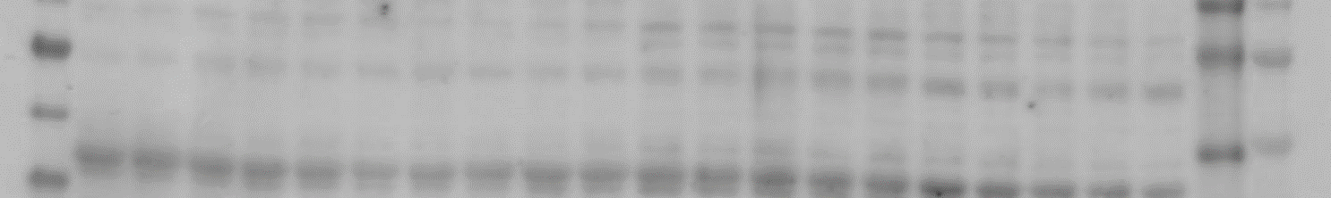
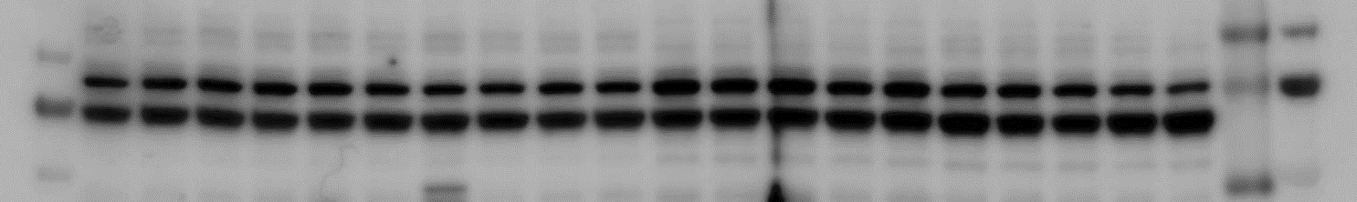
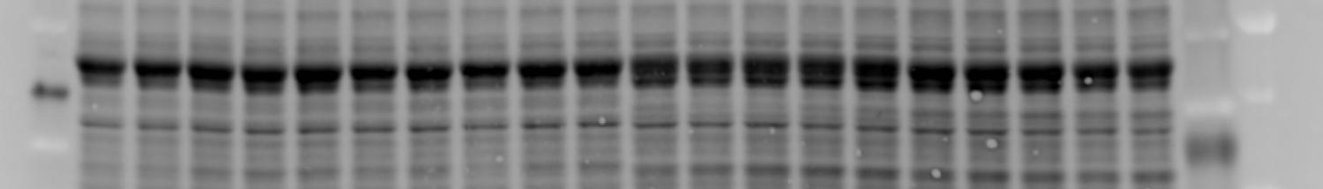
A
B
C
D
YOUNG
OLD
69 kDa-
WT
TG^{AC8}
WT
TG^{AC8}
TFEB^{S210}
69 kDa-
TFEB
Total Protein
Supplemental Figure 9
Notes:
The coordinated lysosomal enhancement/expression and regulation (CLEAR) network

Slide 11
Supplemental Table 1

Slide 12
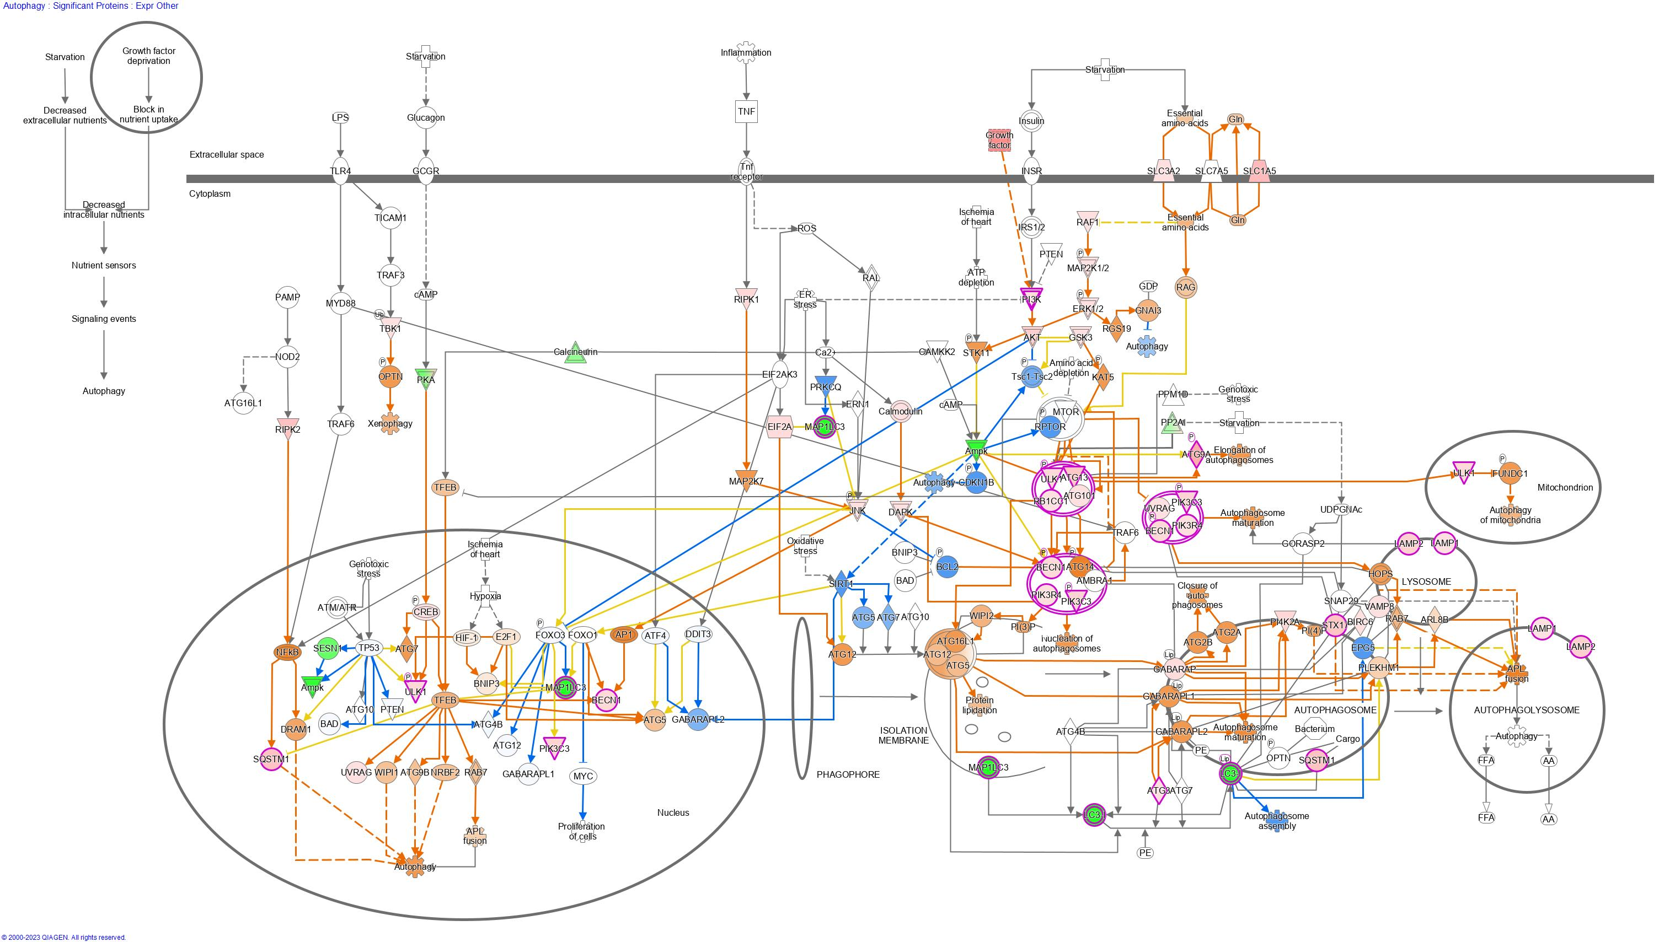
Autophagy (ProteOMICs) in YOUNG TG^{AC8} vs WT
Supplemental Table 2

Slide 13
Autophagy Pathway (ProteOMICs) in YOUNG TG^{AC8} vs WT
Supplemental Table 2

Slide 14
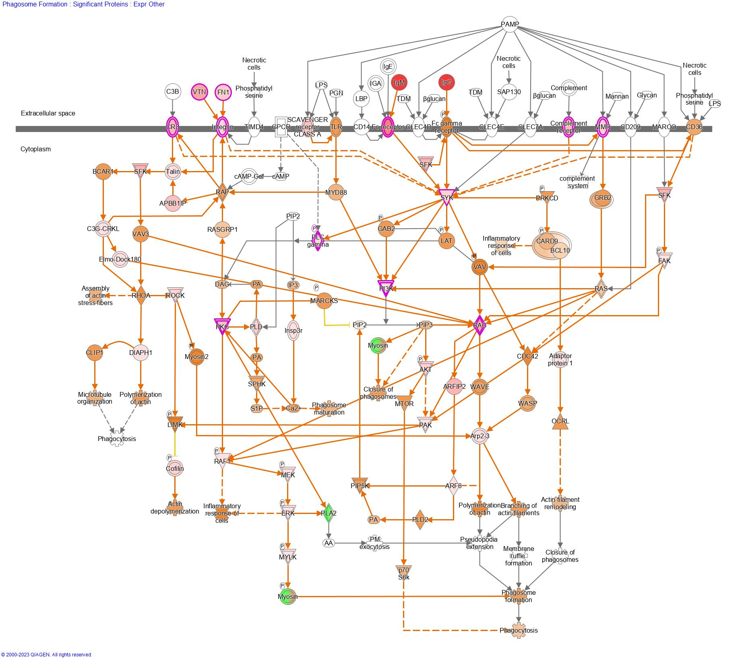
Phagosome Formation (ProteOMICs)
in YOUNG
TG^{AC8} vs WT
Supplemental Table 3

Slide 15
Phagosome Formation Pathway (ProteOMICs) in YOUNG WT/TG^{AC8}
Supplemental Table 3

Slide 16
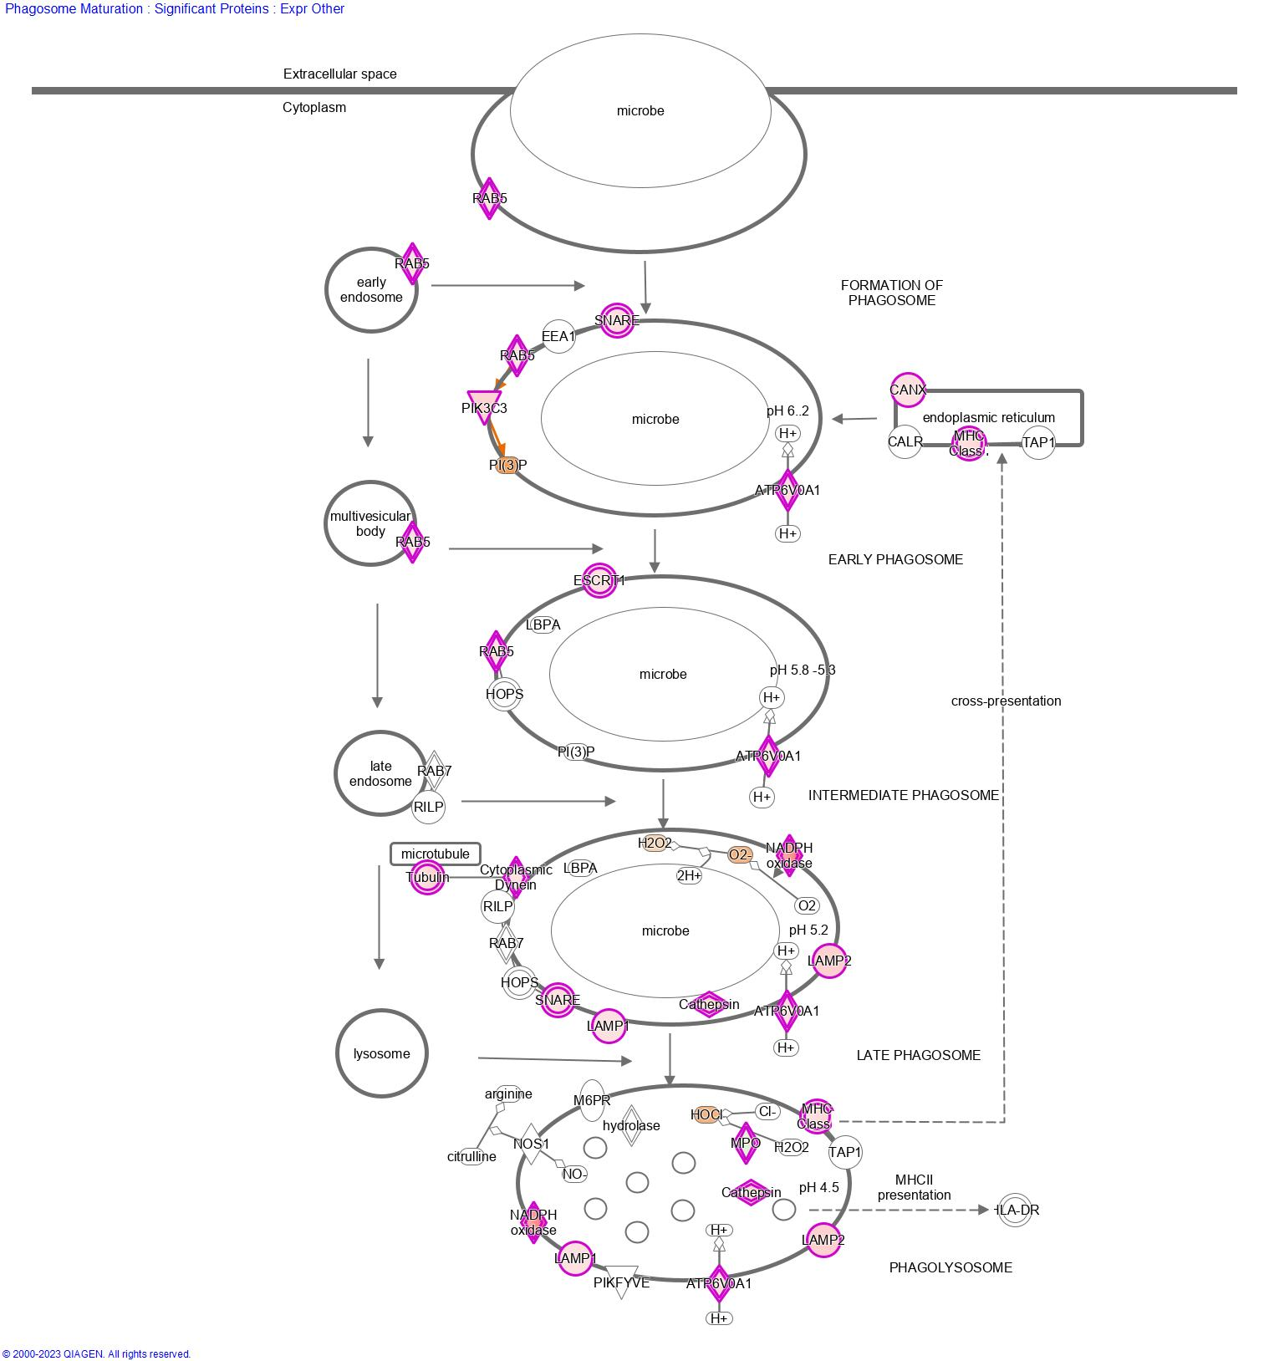
Phagosome Maturation (ProteOMICs) in YOUNG TG^{AC8} vs WT
Supplemental Table 4

Slide 17
Phagosome Maturation
Pathway (ProteOMICs) in YOUNG WT/TG^{AC8}
Supplemental Table 4

