Slide 1
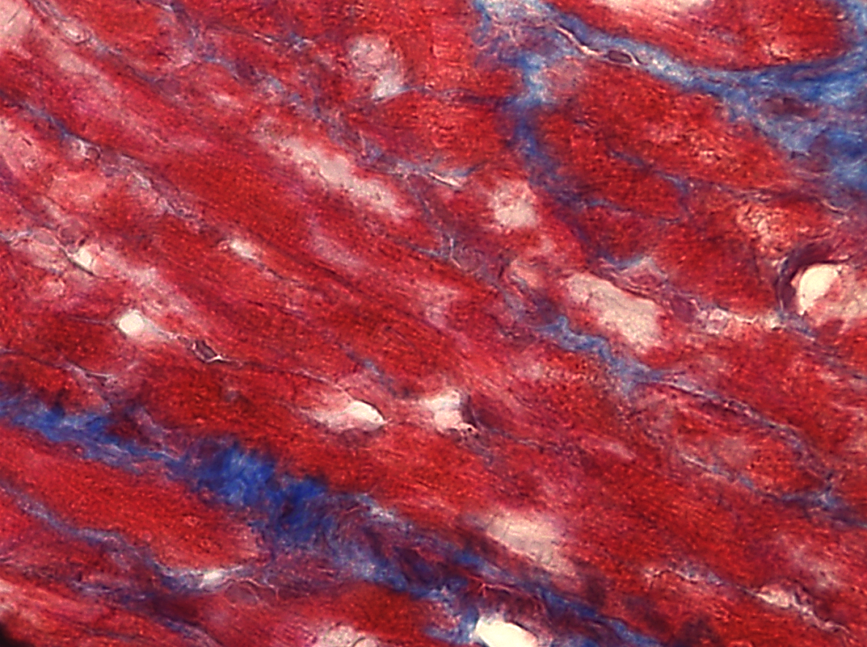
Supplemental Figure 2: Fibrosis in human RAA and LAA samples
A)
RAA AF
RAA SR
10μm
10μm
B)
LAA AF
LAA SR
10μm
10μm
Notes:
Supplemental Figure 2: Fibrosis in human RAA and LAA samples (A) Representative M. Trichrome images of RAA samples from patients with AF and SR. The scatter plot (Mean + SEM) on the right shows the percentage area of fibrosis of the RAA samples. (B) Representative M. Trichrome images of LAA samples (AF and SR). The scatter plot (Mean ± SEM) on the right indicates the percentage fibrosis of LAA samples. All scale bars are 10 μm. N=5 for AF, N=5 for SR, Mann-Whitney U test.

