Slide 1
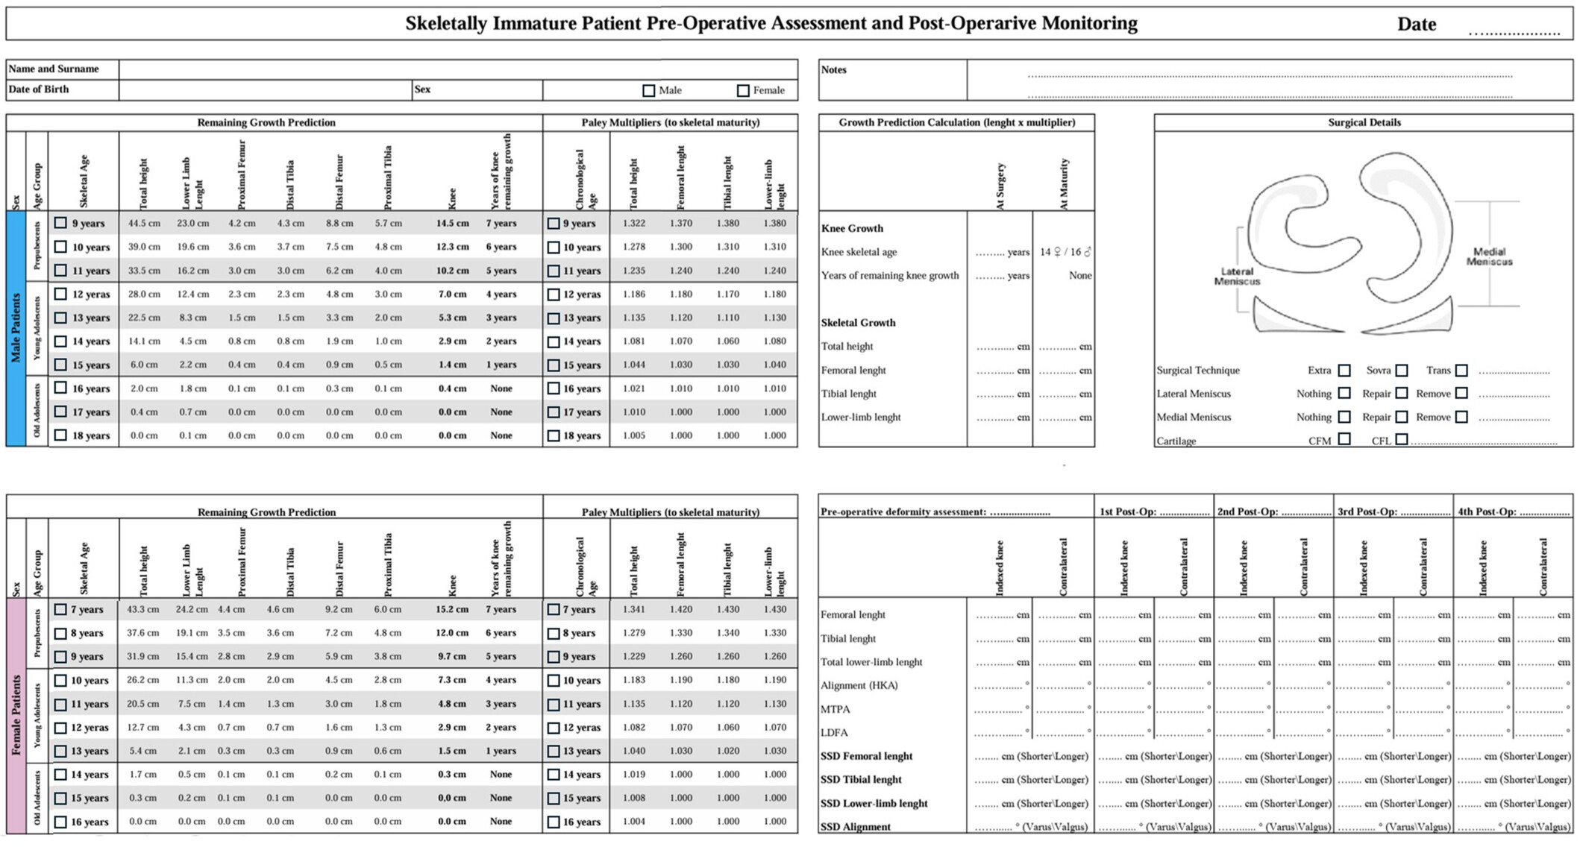
Current concept on assessment and management of anterior cruciate ligament injury in skeletally immature athletes
J. exp. orthop., Volume: 12, Issue: 4, First published: 16 November 2025, DOI: (10.1002/jeo2.70498)
Notes:
Assessment form for skeletally immature patients undergoing anterior cruciate ligament reconstruction.
IF THIS IMAGE HAS BEEN PROVIDED BY OR IS OWNED BY A THIRD PARTY, AS INDICATED IN THE CAPTION LINE, THEN FURTHER PERMISSION MAY BE NEEDED BEFORE ANY FURTHER USE. PLEASE CONTACT WILEY'S PERMISSIONS DEPARTMENT ON PERMISSIONS@WILEY.COM OR USE THE RIGHTSLINK SERVICE BY CLICKING ON THE 'REQUEST PERMISSIONS' LINK ACCOMPANYING THIS ARTICLE. WILEY OR AUTHOR OWNED IMAGES MAY BE USED FOR NON-COMMERCIAL PURPOSES, SUBJECT TO PROPER CITATION OF THE ARTICLE, AUTHOR, AND PUBLISHER.

