Slide 1
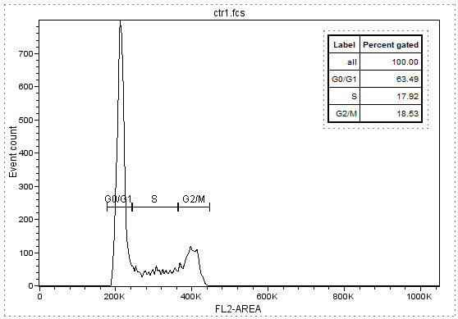
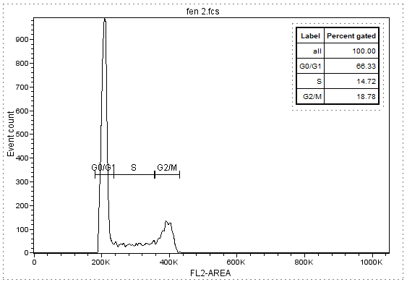
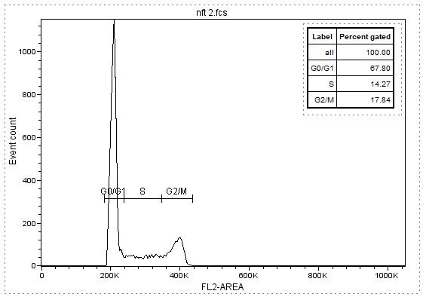
Figure S1. Flow cytometric assay
Cell cycle analysis. Histograms of DNA stained by PI, in a typical experiment.
Ctrl
Fen
PCN-Fen
PI distribution
PI distribution
PI distribution

Slide 2
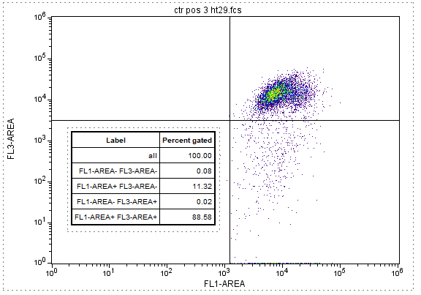
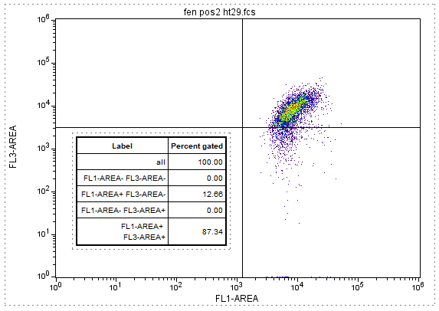
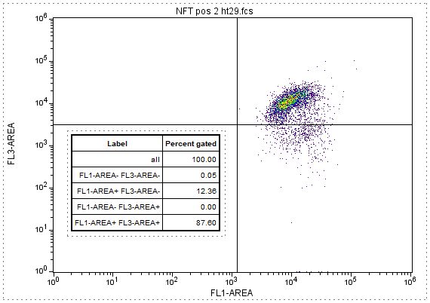
Figure S2. Flow cytometric assay
Mitochondrial Potential Evaluation.
Ctrl
Fen
PCN-Fen

Slide 3
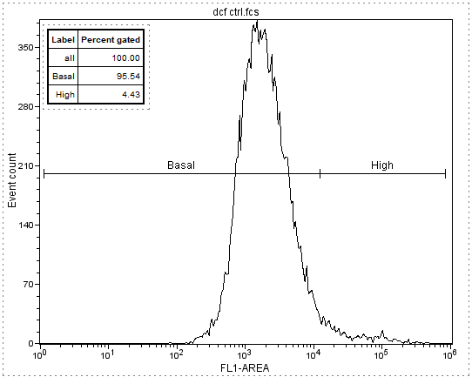
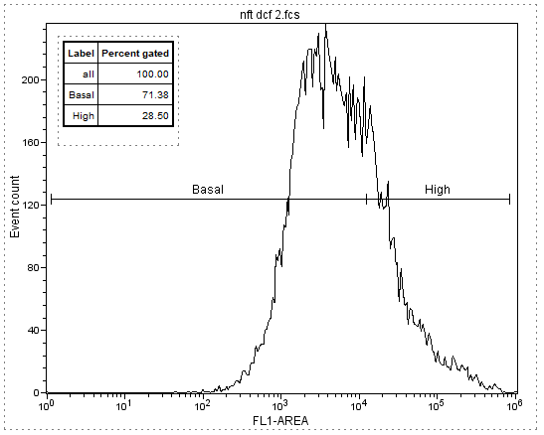
Figure S3. Flow cytometric assay
ROS Production analysis. Histogram of DCF fluorescence in a typical experiment.
Ctrl
Fen
PCN-Fen
DCF Fluorescence
DCF Fluorescence
DCF Fluorescence

Slide 4
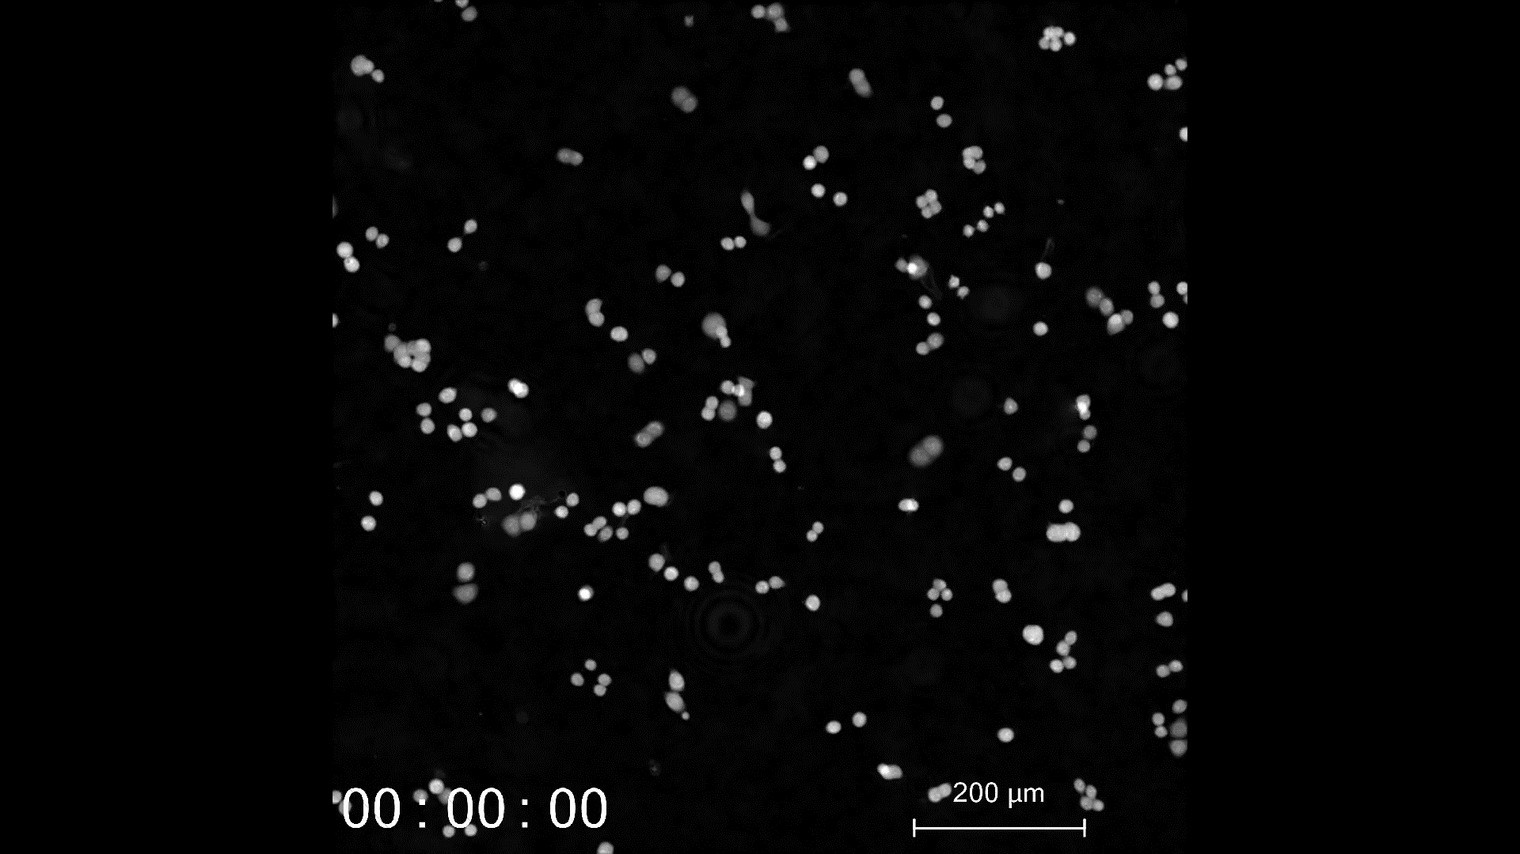
Video S1- Ctrl cells proliferation

Slide 5
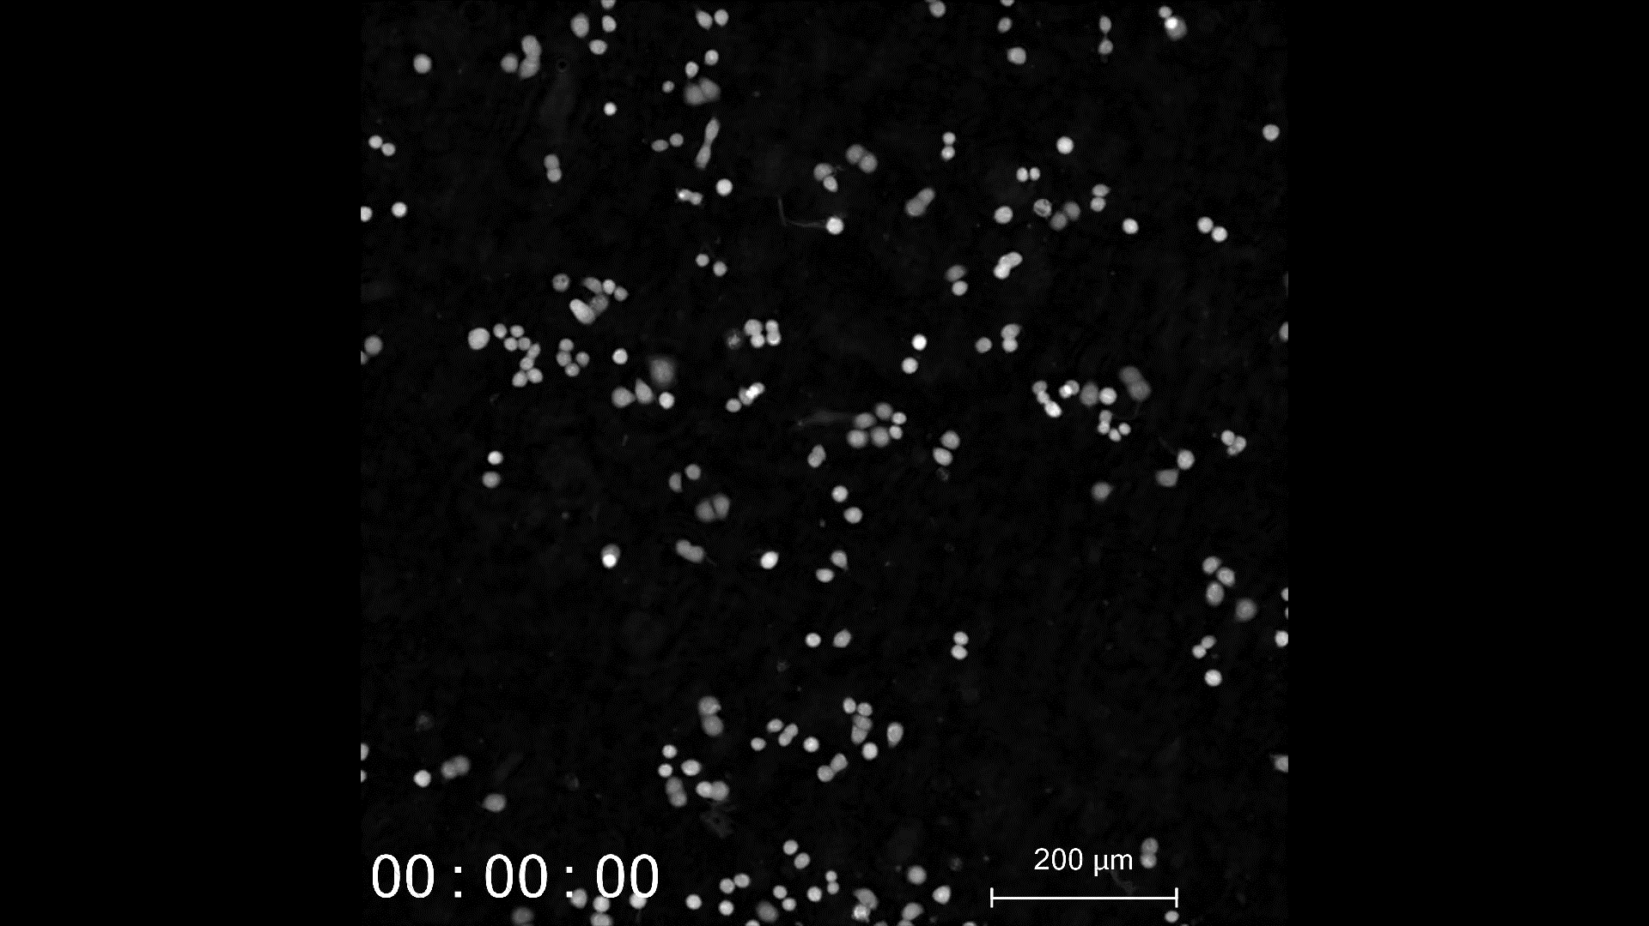
Video S2 – PCN treated cells proliferation

Slide 6
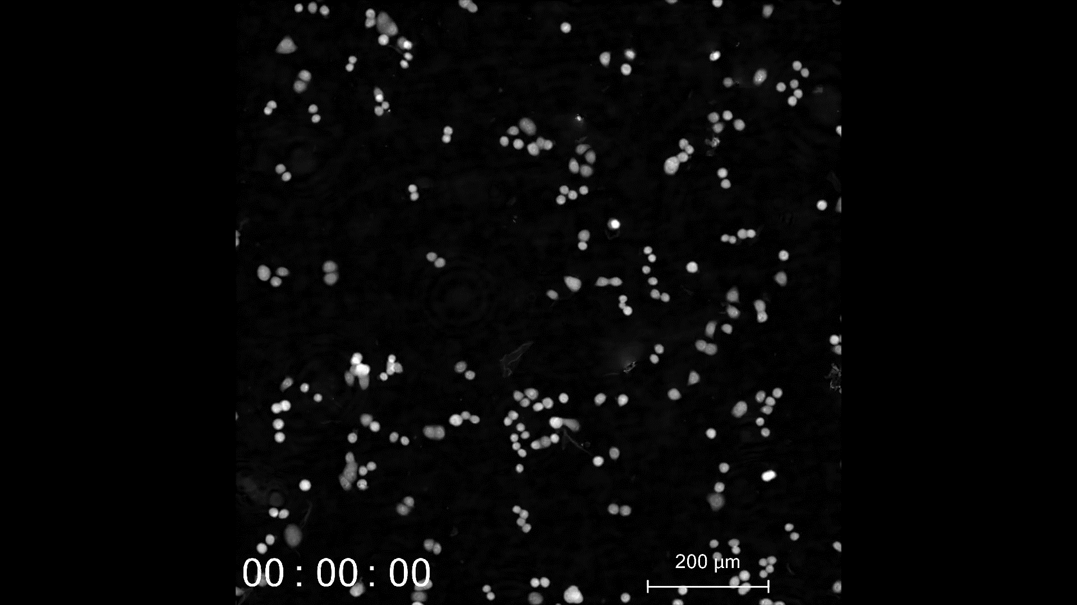
Video S3 – Fen treated cells proliferation

Slide 7
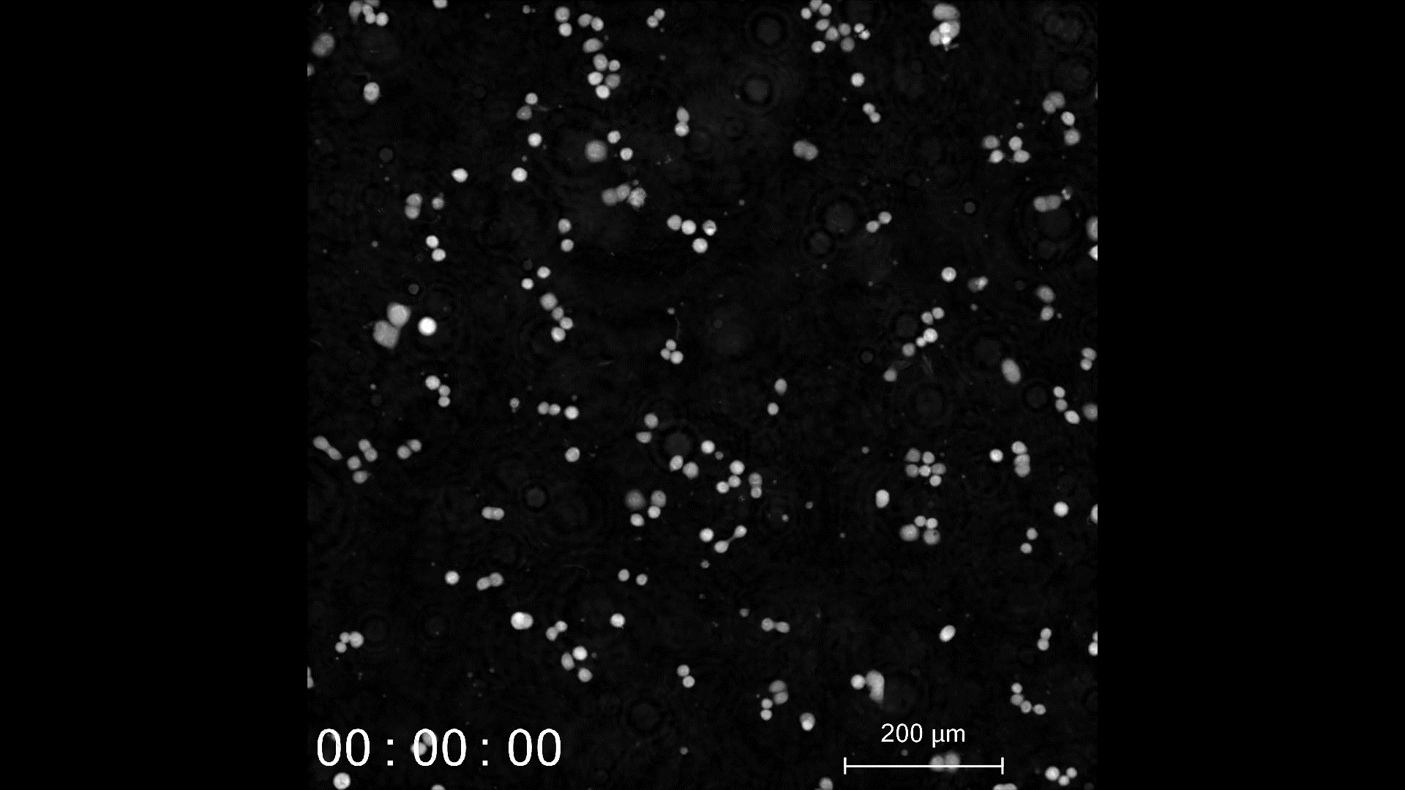
Video S4 - PCN-Fen
treated cells proliferation

